Slide 1
Licensing
Make ReactOS conform again!
Colin Finck <colin@reactos.org>

Slide 2
Motivation
Using more and more licenses inside ReactOS
Importing third-party code wherever possible
Trying to provide an Open-Source alternative to a closed-source product
Notes:
Every Open-Source project has to care, but this is even more relevant to us than to others: Big, many third-party components under different licenses
We want to provide an Open-Source alternative to a closed-source product
Open-Source is only convincing if we get the licensing right
We have to be very careful to not get into legal trouble

Slide 3

Motivation
Visited TripleCheck training on
Open-Source licensing in May
TripleCheck audits software for license identification and compliance
Notes:
TripleCheck, founded by Nuno Brito, friend of ReactOS
He gave a training on Open-Source licensing, invited representatives from big German companies, shared experiences about using Open-Source software in a commercial environment.

Slide 4
What can we combine?

Slide 5
It’s all about the GPL
Unlike Apache, BSD, CDDL, and MIT licenses:
The GPL applies to the entire “work” and not just to the files under GPL
Any “Derivative Work” must be licensed under GPL too
Sources:
https://insights.ubuntu.com/2016/02/18/zfs-licensing-and-linux/
https://opensource.stackexchange.com/a/1712
https://www.softwarefreedom.org/resources/2007/gpl-non-gpl-collaboration.html
Notes:
Most licenses only cover code files referring them.
GPL is different, it also affects other files combined with your GPL code that form a common “work”.
It also affects a so-called “Derivative Work”, and the definition of this is often disputed.

Slide 6
What that means for us
No problems combining “GPLv2 only” with “GPLv2 or later” source files (e.g. vgafontedit)
No problems combining “GPLv2 only” with “2-clause BSD” source files (e.g. ntoskrnl)
But applicable license is “GPLv2 only” in both cases!
Sources:
http://triplecheck.tech/sourcecode.html
Notes:
Difference between “declared license” and “applicable license”: vgafontedit or ntoskrnl are under GPL2 and incompatible with for example GPL3.

Slide 7
What is a Derivative Work?
Free Software Foundation position:
Linking a program to any GPL library makes it a Derivative Work under GPL
Only exception is linking to “major components (compiler, kernel, and so on) of the operating system, unless that component itself accompanies the executable”
Sources:
https://www.gnu.org/licenses/old-licenses/gpl-2.0.html
https://www.gnu.org/licenses/old-licenses/gpl-2.0-faq.html.en#LinkingWithGPL
https://www.gnu.org/licenses/old-licenses/gpl-2.0-faq.html.en#MereAggregation
https://www.gnu.org/licenses/old-licenses/gpl-2.0-faq.html.en#WindowsRuntimeAndGPL
Notes:
Even under strict FSF rules, we could link GPL2-incompatible components with ReactOS components due to the exception. As long as these components are buildable without the rest of ReactOS. Another argument for splitting up the tree!

Slide 8
What is a Derivative Work?
Position presented during TripleCheck training:
If your program depends on a GPL library and this one cannot be exchanged, it is a Derivative Work
If your program uses a GPL library over a well-defined interface that allows exchange, it is not a Derivate Work
Example: Linking to MySQL vs. using it over a Database
Abstraction Layer
Notes:
I think this can be taken as a sane guideline to follow.

Slide 9
What is a Derivative Work?
Other positions:
Linking is only one indicator for a Derivative Work
A self-contained Linux kernel module implementing a filesystem is not a Derivative Work of the Linux Kernel
Example: Ubuntu’s ZFS on Linux
Sources:
https://lwn.net/Articles/548216/
https://insights.ubuntu.com/2016/02/18/zfs-licensing-and-linux/
Notes:
The ZFS case is very prominent. Canonical, as the prominent Linux distributor behind Ubuntu, has conducted a legal analysis and came to the conclusion that shipping a GPL2-incompatible ZFS kernel module is no problem.
Module is self-contained.
Module is not a derivative work of the Linux kernel, but of the OpenZFS code.
Similar interpretation by Jörg Schilling, from which we derive our mkisofs. It is GPLed, but uses CDDL-licensed libraries by him.
Compiling all source files together into one mkisofs binary is not possible. That means without module boundaries.
His libraries and mkisofs as individual works and later combined at linking stage is possible though.

Slide 10
What that means for us
For most of ReactOS, using the GPL doesn’t affect the license of linked modules:
  DLLs and Drivers have well-defined interfaces
  Can be exchanged by their non-GPL Windows counterparts
  “Major components of the operating system” exception applies
We can even link modules under different licenses
Notes:
If we follow the sane guideline presented at TripleCheck, we’re good to go.
Almost all modules are dynamically linked libraries, present well-defined interfaces documented through MSDN, can be exchanged by their Windows counterparts, which are obviously not GPL.
Even for the strict FSF guidelines, we could make use of the “major components of the operating system” exception.

Slide 11
Even better
We can drop the additional lines of our GPL
I see legally no difference between GPL and LGPL
when implementing a Windows counterpart
...
ReactOS may be used, runtime linked, and distributed with non-free software
(meaning that such software has no obligations to open-source, or render
free, their non-free code) such as commercial device drivers and commercial
applications. This exception does not alter any other responsibilities of
the licensee under the GPL (meaning that such software must still obey
the GPL for the free ("open-sourced") code that has been integrated into
the said software).
Notes:
If you have checked our top-level COPYING file, you see that this is a modified GPL2. In my opinion, we can drop these additional lines. They add nothing that isn’t possible right now when taking all terms and guidelines of the GPL into account.
We can leave it as an explanation in an additional file though.
Even more, I see no legal difference between GPL and LGPL when implementing a Windows counterpart. License cannot prevent that a proprietary application links to our DLL. Every ReactOS DLL can be exchanged by its Windows counterpart, obviously provides a well-defined interface.

Slide 12
Some No-Gos remain
Linking GPLv2 rapps to GPLv3 atlex
  atlex becomes a statically linked, integral part of rapps with no Windows counterpart to replace it
Relicensing Microsoft sample code under GPL
Taking any code that has no license associated
Notes:
We had this case during Summer of Code. Gladly, the author of atlex could be convinced to change the license terms to GPL2 or later, so we’re fully conforming now.
Should be obvious, but it has happened in the past, not talking about ReactOS but other projects here: You can’t just take Microsoft sample code and drop a GPL on it. It is made available under very specific terms. But gladly, Microsoft has become more Open-Source friendly recently, so there are simple solutions.
Also, always check what license is associated to a code you find on a website. As soon as you commit new code, make sure that you put a license header on it.

Slide 13
What do we need to do?

Slide 14
Ensuring commercial usage
ReactOS must be usable commercially!
Affected components need to be removed or license terms renegotiated
Examples: FullFAT file system library, wallpapers
Notes:
Easily fixable:
FullFAT is apparently used in fastfat_new, but we still work with fastfat.
Wallpapers can just be replaced, and this is due anyway.

Slide 15
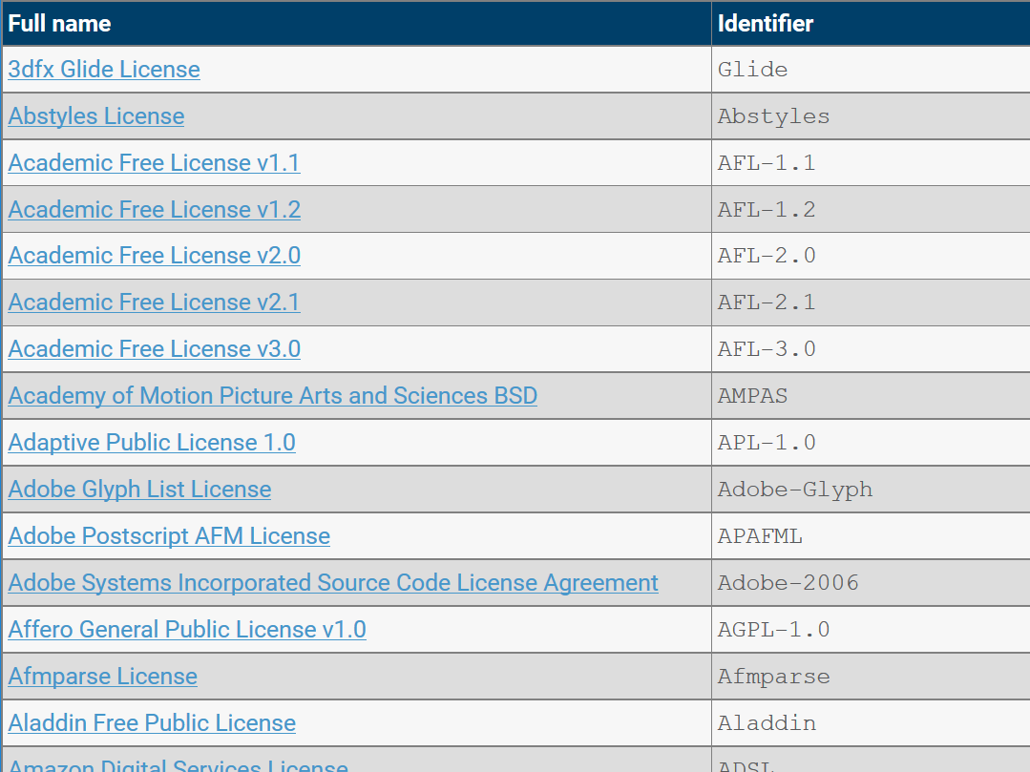
Using SPDX license headers
SPDX defines short, parseable names for most licenses out there.
Example:
/*
* PROJECT: ReactOS Print Spooler Service
* LICENSE: GPL-2.0+ (https://spdx.org/licenses/GPL-2.0+)
* PURPOSE: Functions related to Printers and printing
* COPYRIGHT: Copyright 2015-2017 Colin Finck <colin@reactos.org>
*/
https://spdx.org/licenses/
Notes:
SPDX has become a de-facto standard for declaring license terms.
Suggests some styles for file headers, but doesn’t strictly impose one. We can just continue with our current one and change the LICENSE line.
We currently have “GPL – See COPYING in the top-level directory”, which is too ambiguous. Can change anytime when the source is used somewhere else. And remember, our GPL is modified!

Slide 16
Using .ABOUT files
.ABOUT files give information about third-party components
name: freetype
home_url: https://www.freetype.org
license_spdx: GPL-2.0
license_url: http://git.savannah.gnu.org/cgit/freetype/freetype2.git/tree/docs/LICENSE.TXT?h=VER-2-8
version: 2.8
# which files belong to this component?
about_resource: ../sdk/lib/3rdparty/freetype
# when was this ABOUT file created or last updated?
date: 2017-08-03
Sources:
https://www.aboutcode.org/
http://triplecheck.tech/components/
Notes:
We should put these files in a dedicated folder.
Can also replace the current information files that state when we synchronized what component with upstream.
Syntax pretty simple. All fields important!

Slide 17
Using .ABOUT files
Less information is ambiguous:
FreeType is available under two licenses, and we use the less common option
Some Open-Source projects change the license from one version to another
  Example: iText PDF Library
Notes:
FTL is a BSD-style license, compatible with GPL3.
As we statically link FreeType with our win32k font code, without using a well-defined interface between them, we have to use the GPL2 version.
As soon as FreeType is fully embedded into a FreeType Font Driver, we have the well-defined interface situation again and could use a different license for win32k and the Font Driver. But no reason for that anyway.

Slide 18
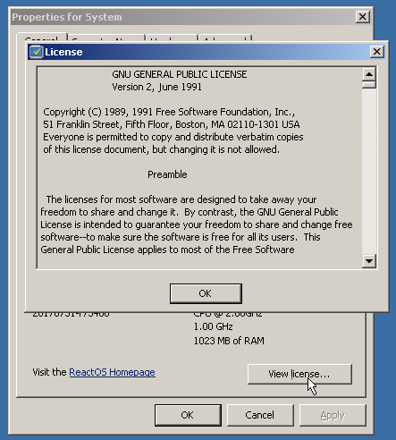
Fulfilling license paperwork
Apache License requires author attribution in prominent places
We could show a complete overview about
all components, authors and licenses here:
Notes:
Apache License is used at least in releases, which we ship with a font for Asian languages, taken from Android.
It requires that you indicate the usage and attribute the autors in prominent places. Often a NOTICE file, but I think our “View license” button is best.
Let’s not limit this to the Apache license though: What I also learned during the TripleCheck training: If a company is interested in commercial usage of Open-Source, they want a list of all involved licenses. So we better compile such a list now and as a by-product, fulfill all possible license paperwork by showing it through the “View license” button.

Slide 19
A Little Housekeeping
Cleaning up modules where multiple GPL versions are used together
Importing Windows driver samples from GitHub:
  MS-PL grants you patent use!
  May replace some of our modified Microsoft sample code under different terms
Sources:
https://github.com/Microsoft/Windows-driver-samples
Notes:
I gave the example: vgafontedit has one file GPL2-only and the other GPL2 or later. Such simple cases can be cleaned up to make the declared and applicable license GPL2 or later for this module.
Whenever Microsoft sample code can help us, we should have a look at their GitHub repo. They have put so much stuff under Ms-PL. Ms-PL is not just an approved Open-Source license, it also enforces all contributors to grant free licenses under the affected patents.
In short that means: If we replace our fastfat file system driver by Microsoft’s sample driver, we don’t just get the reference one for free, we are also safe from patent lawsuits.

Slide 20
Thank you for your attention!
Questions?

Slide 21
Legal Notice
All product names, logos, and brands are property of their respective owners. All company, product and service names used in this presentation are for identification purposes only. Use of these names, logos, and brands does not imply endorsement.
Apache is a registered trademark of The Apache Software Foundation in the United States and/or other countries.
Microsoft and Windows are registered trademarks of Microsoft Corporation in the United States and/or other countries.
SPDX is a registered trademark of The Linux Foundation in the United States and/or other countries.
The “ok” and “cancel” icons have been taken from https://openclipart.org/detail/212394/ok and https://openclipart.org/detail/211689/matticonscancel (released under Creative Commons Zero 1.0 Public Domain License).
The title image has been generated using http://www.wortwolken.com.
TripleCheck is a registered trademark of TripleCheck GmbH in Germany. The TripleCheck Logo is used under permission from Nuno Brito.

